Slide 1
Calculus Practice
Directions here
Start Quiz Now

Slide 2
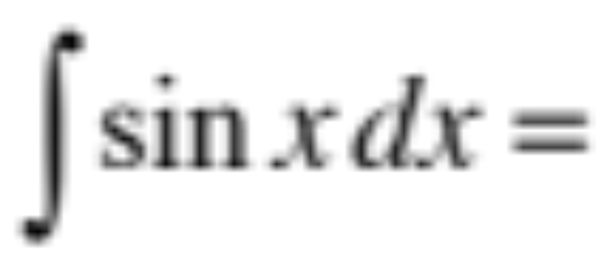


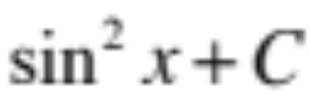
a.
b.
c.
d. None of these

Slide 3
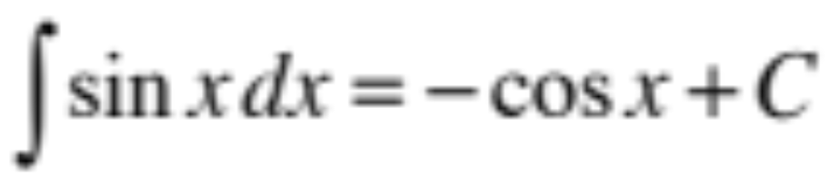
CORRECT!
NEXT QUESTION

Slide 4
INCORRECT
TRY AGAIN
SEE CORRECT ANSWER

Slide 5
The correct answer:
NEXT QUESTION

Slide 6
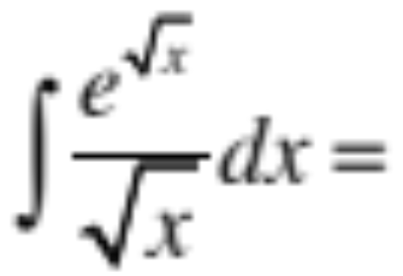
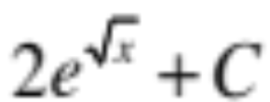
a.
b.
c.
d. None of these

Slide 7
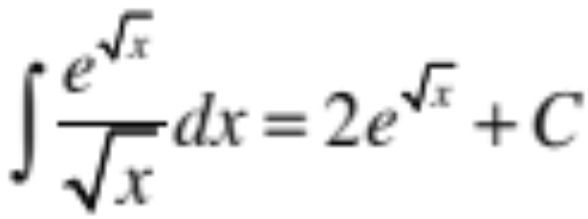
CORRECT!
NEXT QUESTION

Slide 8
INCORRECT
TRY AGAIN
SEE CORRECT ANSWER

Slide 9
The correct answer:
NEXT QUESTION

